Slide 1
Lesson objective
Title: Solving equations
Aim – be able to:
Solve equations using inspection and backtracking
Plan
Review vocabulary
Backtracking single step
Backtracking 2 step
Need whiteboards and calculators.

Slide 2
Vocabulary
Variable (pronumeral)
A letter or symbol representing a number
Solving
Finding the value of an unknown variable

Slide 3
Inverse of an equation
Inverse means something that is the opposite or reverse of something else.
Inverse means something that is the _______ or reverse of something else.
Inverse means something that is the _______ or ______ of something else.

Slide 4
What is the inverse of….
Adding 5?
Subtracting 11?
Multiplying by 5?
Dividing by 4?

Slide 5
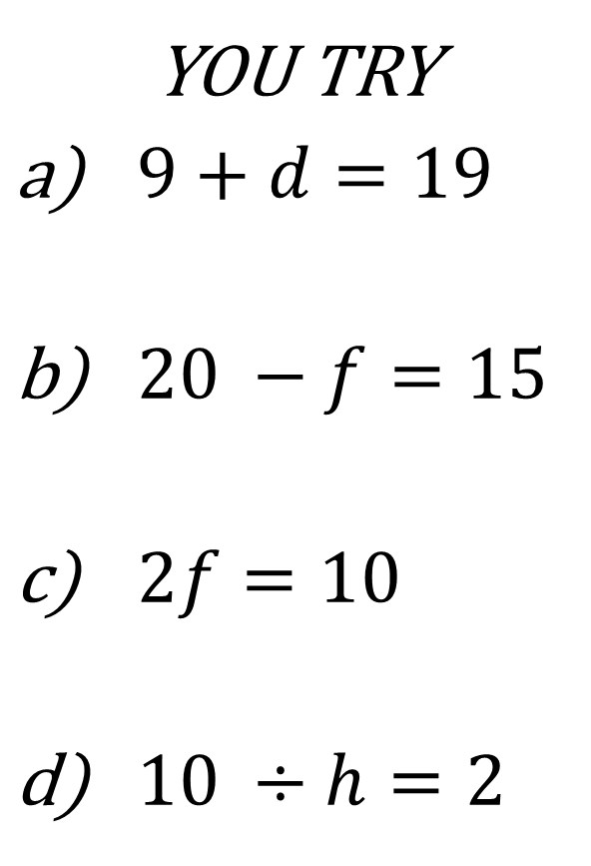
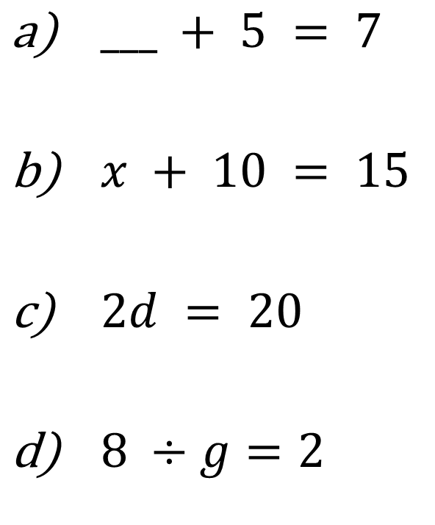
Solving through inspection
YOU TRY
$9+d=19$
$20 −f=15$
$2f=10$
$10 ÷h=2$
$___ + 5 = 7$
$x + 10 = 15$
$2d = 20$
$8 ÷g=2$

Slide 6



Equations with one step
We work equations backwards by looking to see what operations are being done to the unknown value (think BIMDAS!) - BACKTRACKING
I’m thinking of a number……..
$$x+4=9$$
$$4k=92$$
$$3d=87$$

Slide 7
Individual practice
Questions 1 – 36
Exercise C “Finding the missing number”

Slide 8


Equations with more than one step
We work equations backwards by looking to see what operations are being done to the unknown value (think BIMDAS!)
I’m thinking of a number…….
$$4k−4=92$$
$$3d+7=64$$

Slide 9
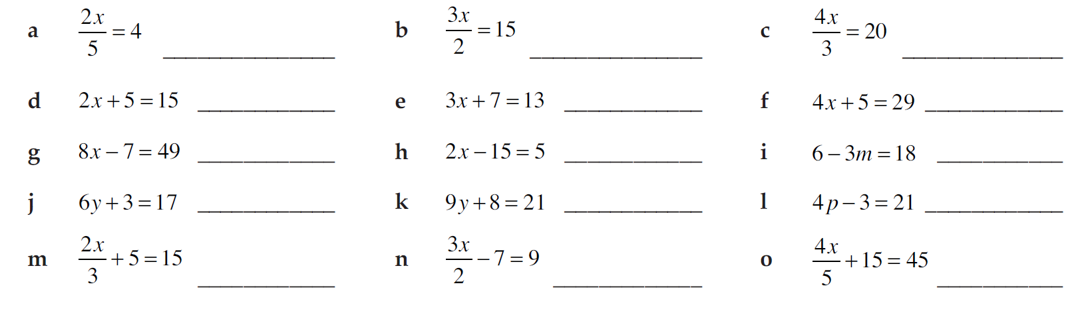
Make flowcharts so you can solve the equations:
a)
b)
c)
Write letter in first box
Write operations on each forward arrow in order
Answer in last box
Write the inverse on the back arrows
Solve unknown variable
MQ7 p448

Slide 10
Make flowcharts so you can solve the equations:
a)
b)
c)
MQ7 p448

Slide 11
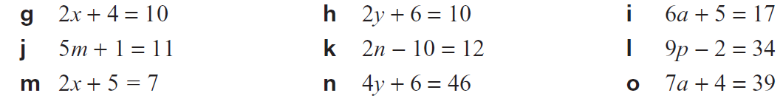
Make flowcharts for these so you can work out the starting number
MQ7 p448

Slide 12
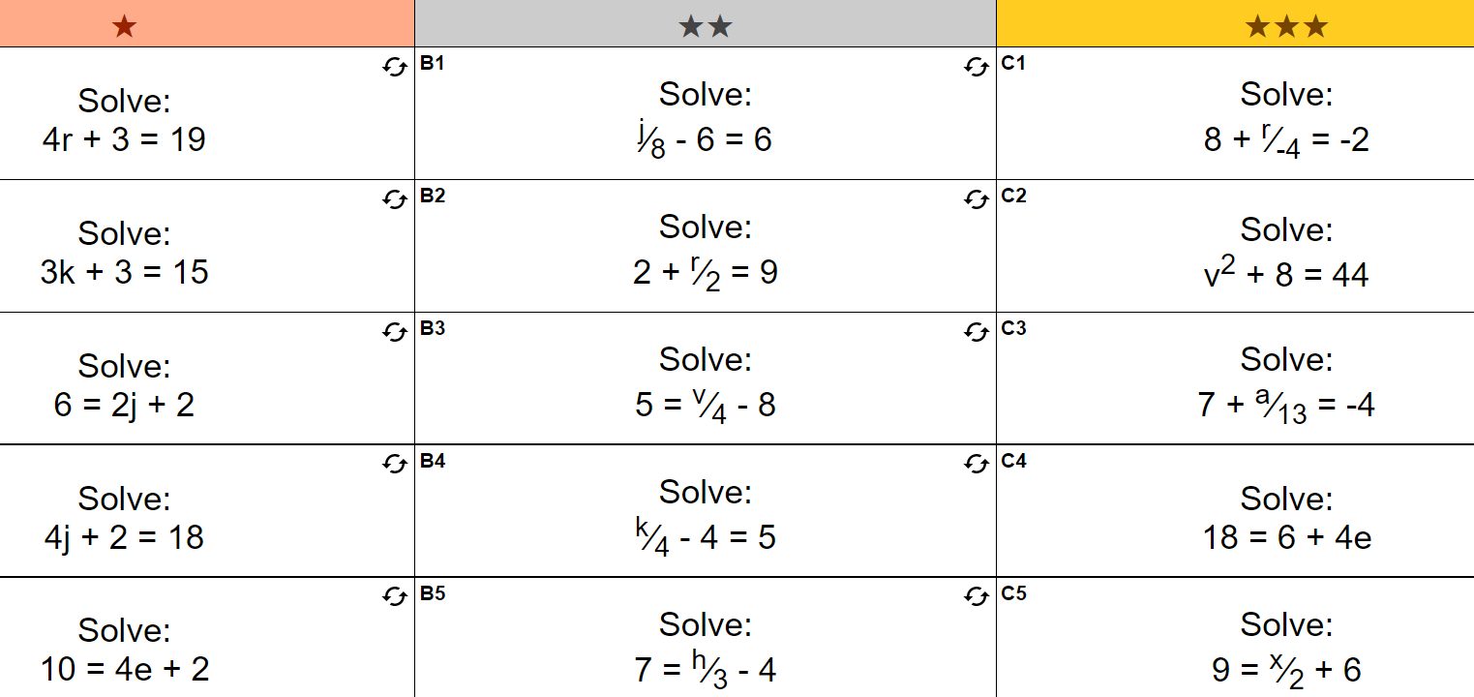

Slide 13
